Slide 1


Pimpri Chinchwad Education Trust’s Pimpri Chinchwad College of Engineering and Research, Ravet, Pune Department of Computer Engineering
Data Structures
Dr. Govind R. Suryawanshi
Asst. Prof.

Slide 2
UNIT- III
Basic concept, Queue as Abstract Data Type, Representation of Queue using Sequential organization, Queue Operations, Circular
Queue and its advantages, Multi-queues, Linked Queue and Operations.
Deque-Basic concept, types (Input restricted and Output restricted),
Priority Queue- Basic concept, types (Ascending and Descending).

Slide 3
QUEUES

Slide 4
INTRODUCTION TO QUEUE
DEFINITION:
A queue is a data structure that provides temporary storage of data in such
a way that the element stored first will be retrieved first.
This method is also called FIFO – First In First Out.
EXAMPLE:
In real life we can think of queue as a queue of vehicles waiting at the petrol pump, people waiting at the bus stop for the bus etc. The first person to enter the queue is the first one to leave the queue. Similarly last person to join the queue is the last person to leave the queue.

Slide 5
OPERATIONS ON QUEUE
A queue is a linear data structure.
It is controlled by two operations: insertion and deletion.
Insertion operation takes place from the rear end of the queue and deletion operation takes place from the front end of the queue.
Insertion operation adds an element to the queue.
Deletion operation removes an element from the queue.
There are two variables FRONT and REAR. FRONT points to the beginning of the filled queue and takes care of deletion operation. REAR points to the end of the queue and takes care of insertion operation.
These two operations implement the FIFO method .

Slide 6
IMPLEMENTATION OF QUEUE
Queue can be implemented in two ways:
As an Array
As a Linked List

Slide 7
QUEUE AS AN ARRAY
Array implementation of Queue uses
30
20
10
4
an array to store data
an integer type variable usually called the FRONT, which points to the beginning of the array and an integer variable REAR, which points to the end of the filled array.
3
2
2
REAR
1
0
0
FRONT

Slide 8
INSERTION OPERATION
Initially when the queue is empty, FRONT and REAR can have any integer value other than any valid index number of the array. Let FRONT = -1; REAR=-1;
The first element in the empty queue goes to the 0th position of the array and both FRONT and REAR are initialized to value 0.
After this every insertion operation increase the REAR by 1 and inserts new data at that particular position.
As arrays are fixed in length, elements can not be inserted beyond the maximum size of the array. Pushing data beyond the maximum size of the queue (i.e. when REAR = MAX SIZE -1) results in “data overflow”.

Slide 9
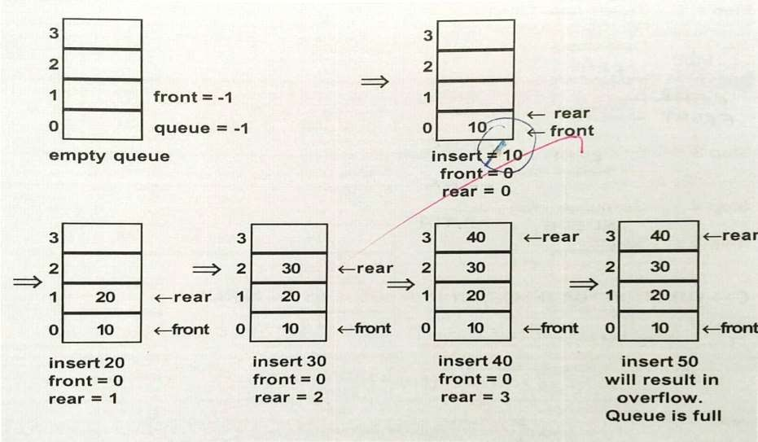
INSERTION OPERATION EXPLAINED
insert 10
front = 0
rear = 0

Slide 10
DELETE OPERATION
The delete operation deletes the very first item from the queue.
Any attempt to delete an element from the empty queue (when FRONT+REAR=-1) results in “data underflow” condition.
Each time the deletion operation is performed, the FRONT variable is decremented by 1.
When there is only one element in the queue, deletion operation of that element makes the queue empty and both FRONT and REAR will be assigned the value -1.

Slide 11
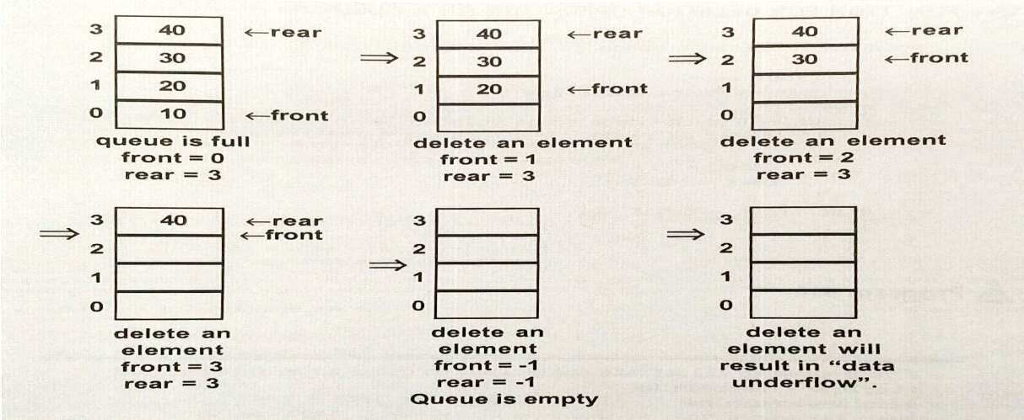
DELETION OPERATION EXPLAINED

Slide 12
PROGRAM TO ILLUSTRATE OPERATIONS ON QUEUE AS AN INTEGER ARRAY
#include<iostream.h> #include<conio.h> #define size 4
class queue
{
int data[size]; int front,rear;
public:
queue()
{ front=-1; rear=-1; }
else if(rear == -1) ^{void display()}
{ rear++; {
front++; }
for (int i=front;i<=rear; i++)
cout<< data[rear]; }
else
rear++; cout<<"Enter Data : "; cin>>data[rear]; }
void main()
{
queue q; int ch; do
{
cout<<"\n1. Insert\n2. Delete\n3. Display\n4.Quit\nEnter Choice(1-3) "; cin>>ch;
switch(ch)
{
case 1: q.insert();break;
case 2: q.deletion();break;
case 3. q.display();
}
}while(ch!=3); }
void queue::deletion()
{
if(front==-1)
{ cout<<"\n Queue is empty"; return;
}
cout<<data[front]<<" deleted"<<endl;
if(front==rear)
void insert(); void deletion();
};
void queue::insert()
{ if(rear==size-1)
{ cout<<"\n queue is full"; return;
}
{ front=-1;rear=-1; } else
front++; }

Slide 13
PROGRAM TO ILLUSTRATE OPERATIONS ON QUEUE AS AN ARRAY OF OBJECTS
#include<iostream.h> #include<conio.h> struct item
else if(rear == -1) ^{void display()}
{ rear++; {
front++; }
for (int i=front;i<=rear; i++)
cout<< data[rear]].ino<<
data[rear].name; }
{ int ino;
char name[20]; };
else
rear++; cout<<"Enter Data : "; cin>>data[rear].ino>>
data[rear].name; } void queue::deletion()
{
if(front==-1)
void main()
{
queue q; int ch; do
{
cout<<"\n1. Insert\n2. Delete\n3. Display\n4.Quit\nEnter Choice(1-3) "; cin>>ch;
switch(ch)
class queue
{
item data[4]; int front,rear;
public:
queue()
{ front=-1;
rear=-1; }
{ cout<<"\n Queue is empty";
return; }
void insert();
void deletion();
cout<<data[front].ino<<" deleted"<<endl;
if(front==rear)
};
void queue::insert()
{ case 1: q.insert();break; case 2: q.deletion();break;
case 3. q.display();
{ if(rear==size-1)
{ cout<<"\n queue is full"; return; }
{ front=-1;rear=-1; } else
}
}while(ch!=3); }
front++; }

Slide 14
APPLICATIONS OF QUEUE
A queue is an appropriate data structure on which information is stored and then retrieved in FIFO order. The applications of queue are as follows:
Queues find their use in CPU scheduling, printer spooling, message queuing, computer networks etc.
In time sharing system queues help in scheduling of jobs.

Slide 15
QUEUE AS A LINKED LIST
Linked list implementation of queue uses:
A linked list to store data
A pointer FRONT pointing to the beginning of the queue and a pointer REAR pointing to the end of the queue.
NOTE: Each node of a queue as a linked list has two parts : data part and link part and is created with the help of self referential structure.
The data part stores the data and link part stores the address of the next node of the linked list.
NODE
REAR
FRONT
DATA
LINK

Slide 16
PROGRAM TO ILLUSTRATE OPERATIONS ON QUEUE AS A LINKED LIST
#include<iostream.h> #include<conio.h> struct node
{
int data; node *next;
};
class queue
{
node *rear,*front;
public:
queue()
{ rear=NULL;front=NULL;} void qinsert();
void qdelete();
void qdisplay();
};
void queue::qinsert()
{
node *temp; temp=new node; cout<<"Data :"; cin>>temp->data; temp->next=NULL; if(rear==NULL)
{
rear=temp; front=temp;
}
else
{
rear->next=temp; rear=temp;
}
}
void queue::qdelete()
{
if(front!=NULL)
void main()
{
queue q1; char ch; do
{
cout<< "i. insert\n
d. Delete\ns. Display
\n q. quit "; cin>>ch; switch(ch)
{
case 'i' : q1.qinsert();break; case 'd' : q1.qdelete();break; case 's' : q1.qdisplay();
}
}while(ch!='q'); }
{ node *temp=front; cout<<front->data
<<"deleted \n"; front=front->next; delete temp; if(front==NULL)
rear=NULL; }
else
cout<<“empty Queue “;
}
void queue::qdisplay()
{
node *temp=front; while(temp!=NULL)
{ cout<<temp->data; temp=temp->next; } }

Slide 17
PROGRAM TO ILLUSTRATE OPERATIONS ON QUEUE
AS A LINKED LIST : Explanation
#include<iostream.h>
#include<conio.h>
struct node
{
int data; node *next;
};
Self Referential Structure: These are special structures which
contains pointers to themselves.
Here, next is a pointer of type node itself.
Self Referential structures are needed to create Linked Lists.
class queue
{
node *rear,*front; // front point to the beginning of the queue and rear points to the end of the queue public:
queue()
{ rear=NULL;front=NULL;} void qinsert();
void qdelete(); void qdisplay();
// Initializes front and rear to NULL
};

Slide 18
DISADVANTAGE OF NORMAL QUEUE
The queue as an array suffers from one major drawback.
As arrays are fixed in size, elements can not be inserted beyond the maximum size of the array, even though in reality there might be empty slots in the beginning of the queue.
2
FRONT
5
REAR
In this example, queue is considered as full although there are two empty spaces in the beginning of the queue.
0
1
2
3
4
5
 |  | 30 | 40 | 50 | 60

Slide 19
Circular Queue

Slide 20
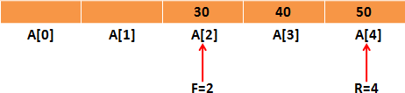
Why Circular Queue is needed?
Problem:
– Wastage
of memory in standard queue

Slide 21
What is Circular Queue?
The Arrangement of the elements Q[0], Q[1], ...,Q[n] in a
circular fashion with Q[1] following Q[n] is called Circular Queue.
The last node is connected to first node to make a circle.
Initially, both Front and Rear pointers points to the beginning of the array.
It is also known as “Ring Buffer”.

Slide 22
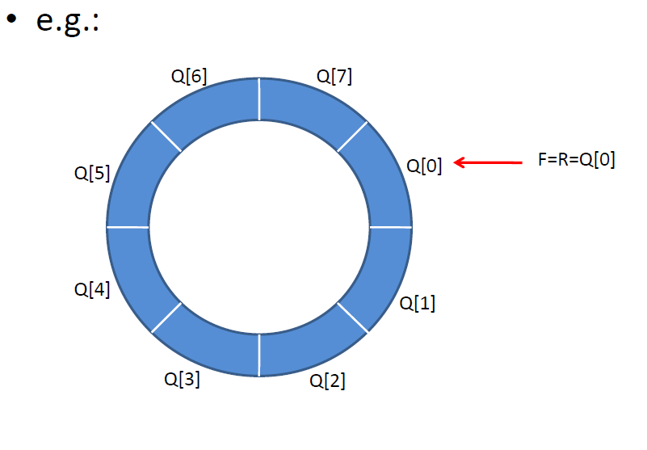

Slide 23
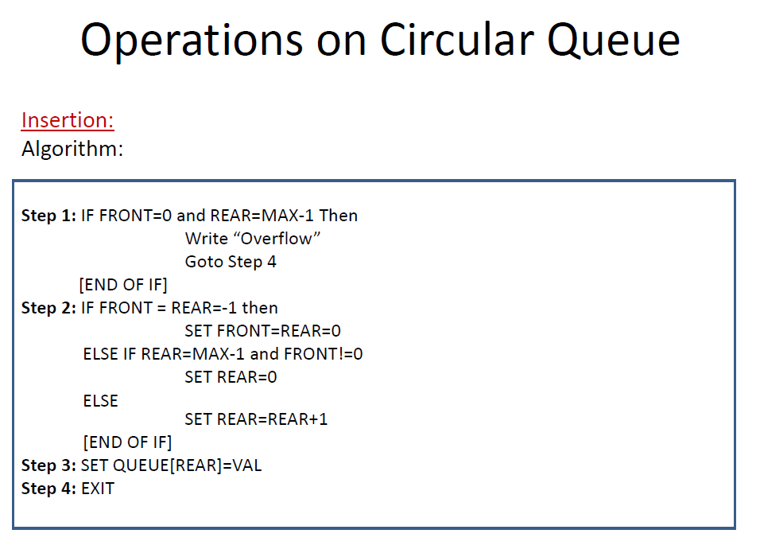

Slide 24
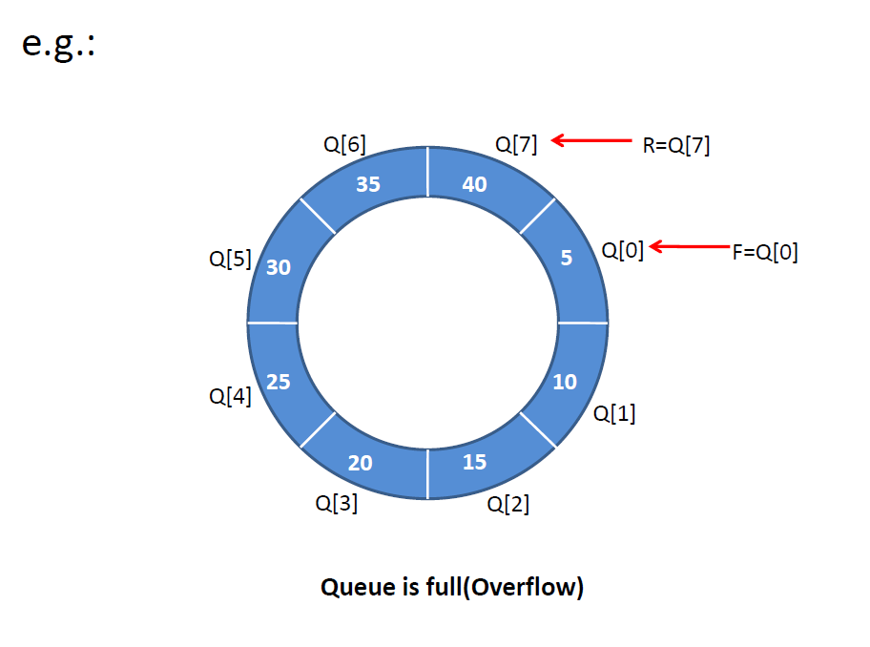

Slide 25
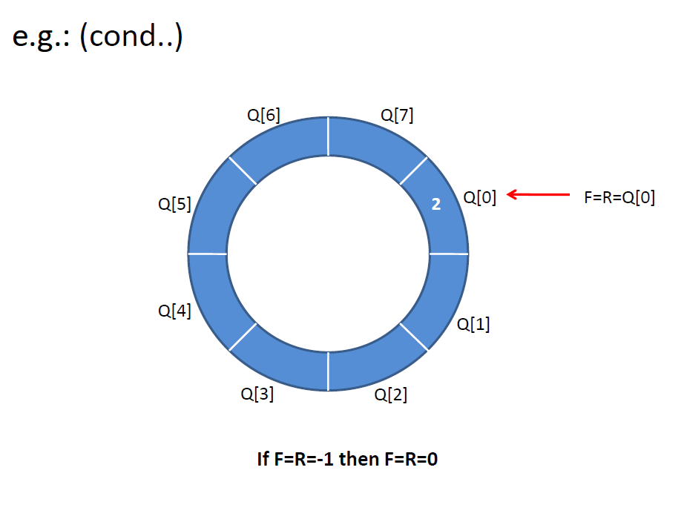

Slide 26
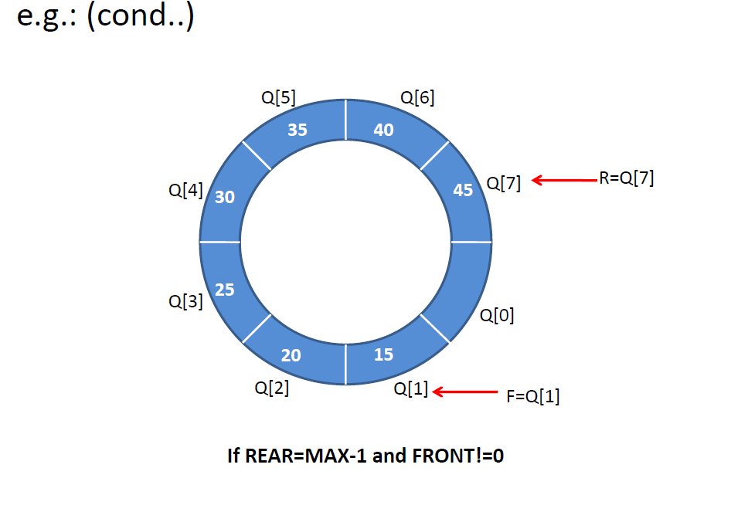

Slide 27
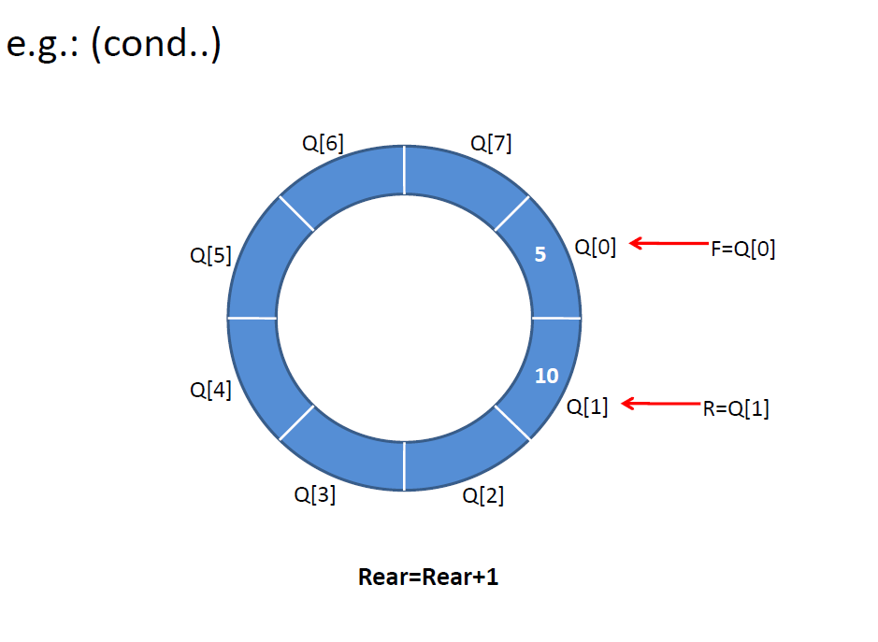

Slide 28
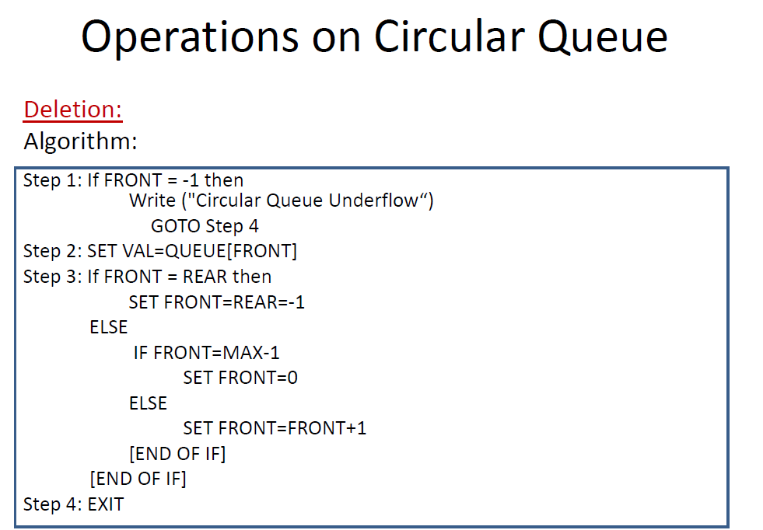

Slide 29
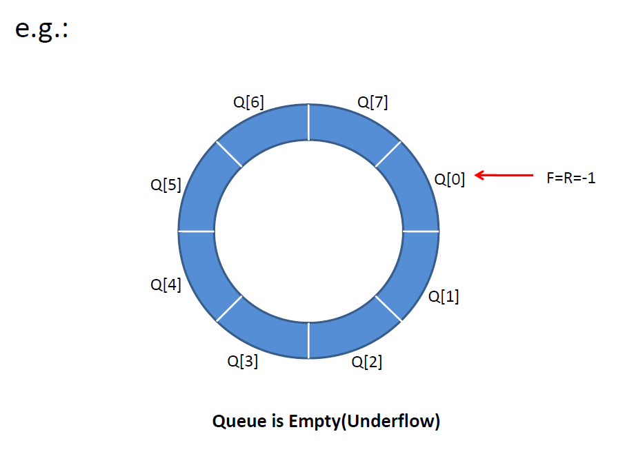

Slide 30
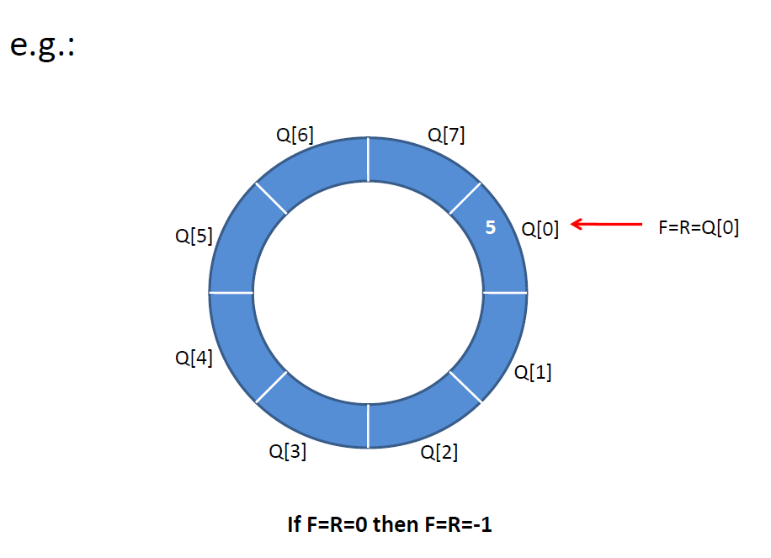

Slide 31
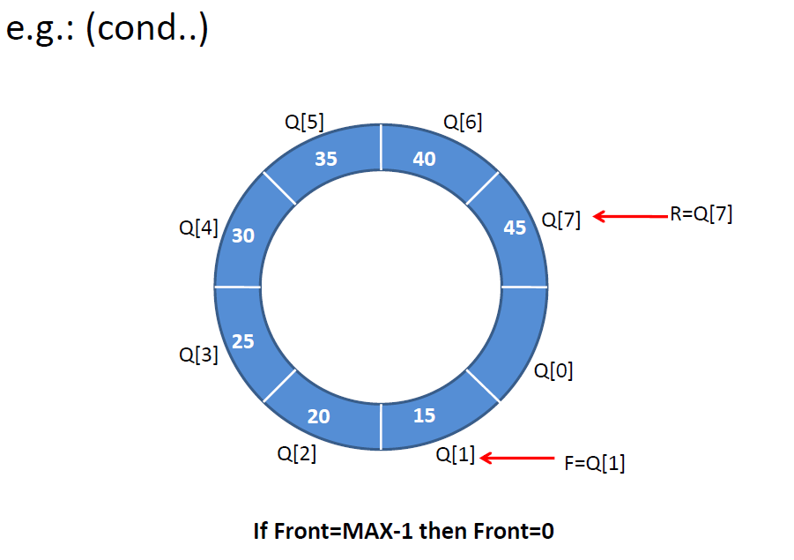

Slide 32
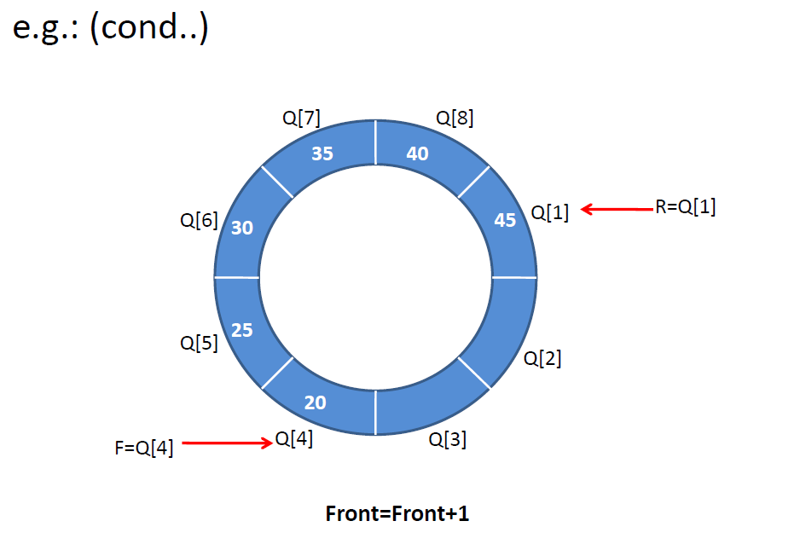

Slide 33
Priority Queue

Slide 34
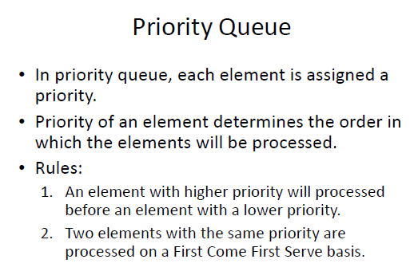
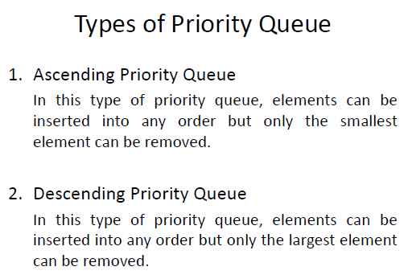

Slide 35
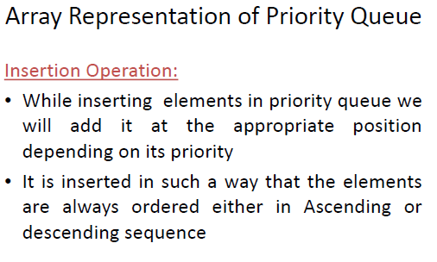
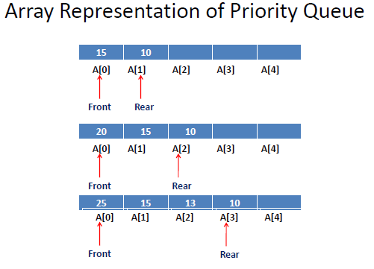

Slide 36
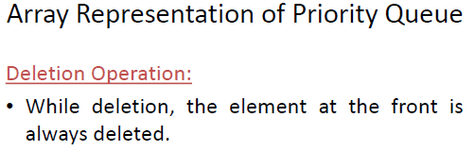
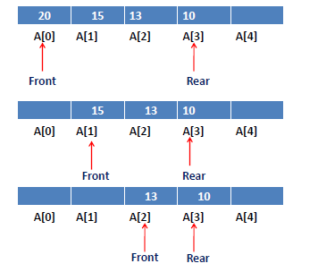

Slide 37
Double Ended Queue

Slide 38
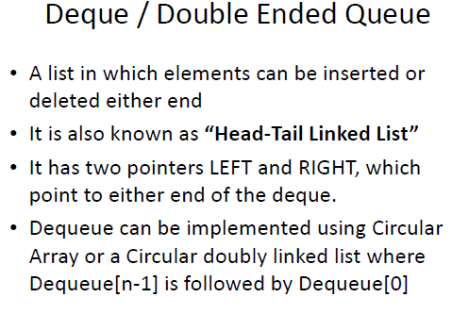
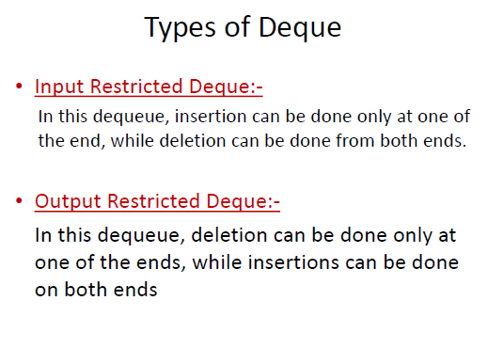

Slide 39
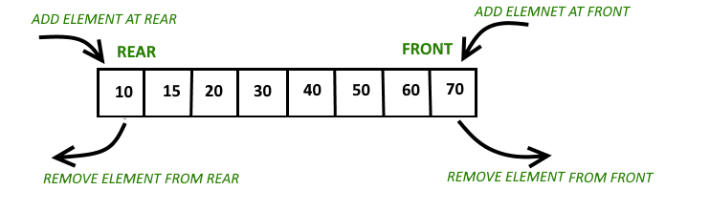
Double Ended Queue

